Slide 1

Buffer Tree
Muhammad Sabihul Hasan, Agha Syed Nasir Mahmood Azeemi,
Salman Muhammad Younus, Syed Hammad Ali, Muhammad Faraz Ozair
Department of Computer Science,
^{Habib University}
1

Slide 2
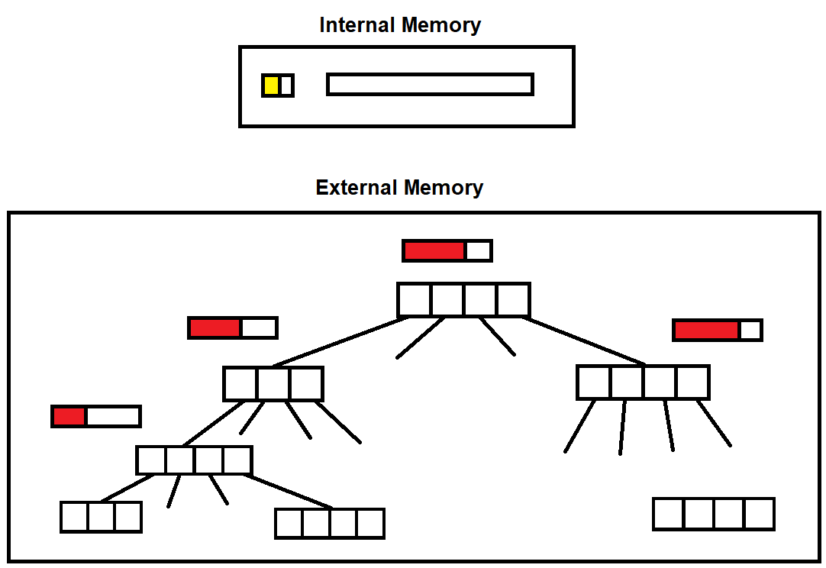
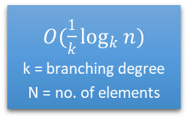
Initial Design / Approach
External memory
Internal memory
$O({\frac{1}{k}log}_{k}{n})$
k = branching degree
N = no. of elements
Buffers
2

Slide 3
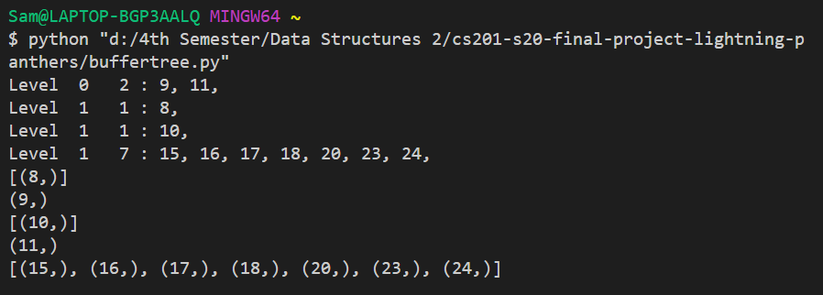
Implementation using Python lists
Operations
Tree = Buffertree(min degree per node)
Tree.bufferinsert(element, operation)
where operation = [insert, delete, search]
Tree.print_tree(root_node)
Tree.inorder(root_node)
3

Slide 4
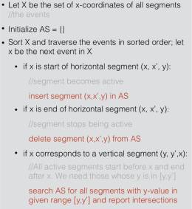
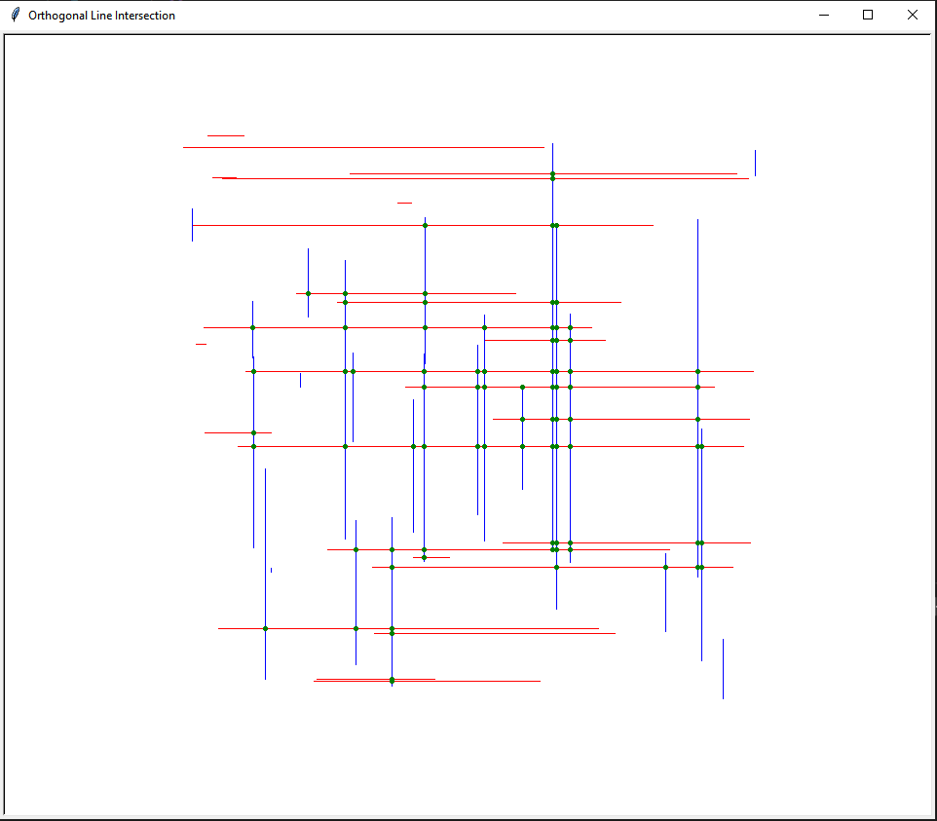
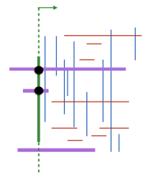
Application
DESIGN
OUR APPLICATION
Orthogonal Line Segment Intersection
Idea
4

Slide 5


